Slide 1
Team Viewer
Lecturer: Ngo Huy Bien
Software Engineering Department
Faculty of Information Technology
VNUHCM - University of Science
Ho Chi Minh City, Vietnam
nhbien@fit.hcmus.edu.vn

Slide 2

Objectives

Slide 3

Contents

Slide 4

References

Slide 5
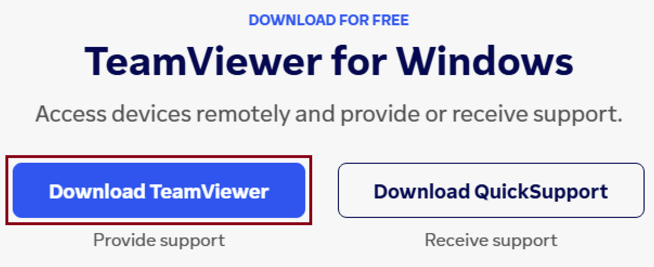
1. Download Team Viewer Host
https://www.teamviewer.com/en/download/windows/

Slide 6
2. Install Team Viewer on a Remote Computer (e.g. a Server)
You must install Team Viewer to allow remote access.

Slide 7
3. Log in Team Viewer

Slide 8
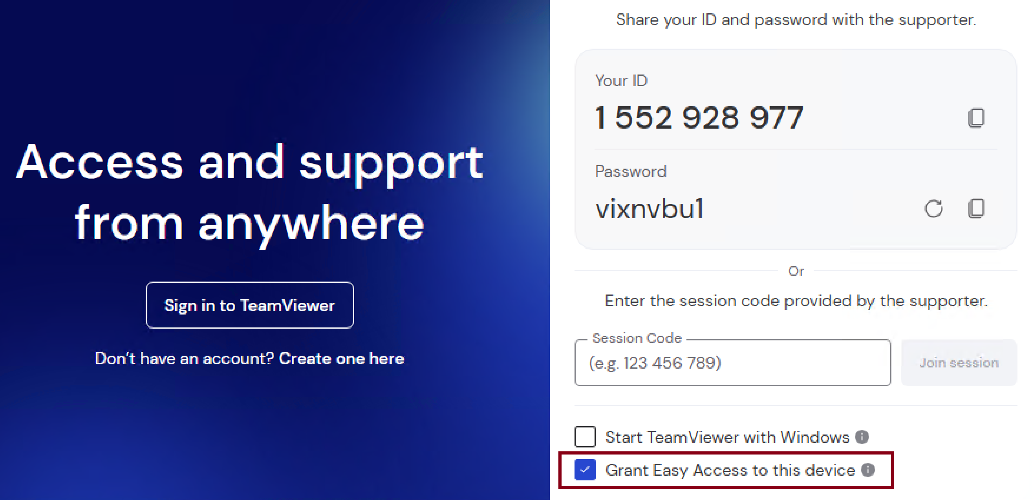
4. Allow Remote Management for the Remote Computer

Slide 9


Slide 10
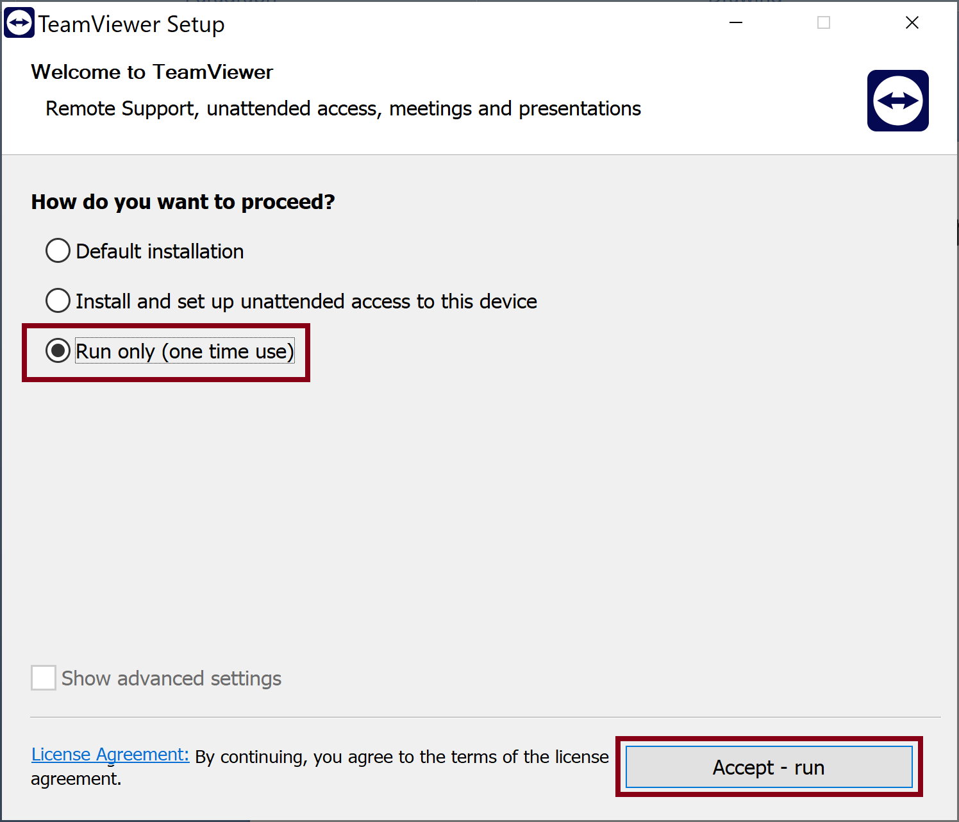
1. Run Team Viewer on Client

Slide 11
2. Sign in Team Viewer Account

Slide 12
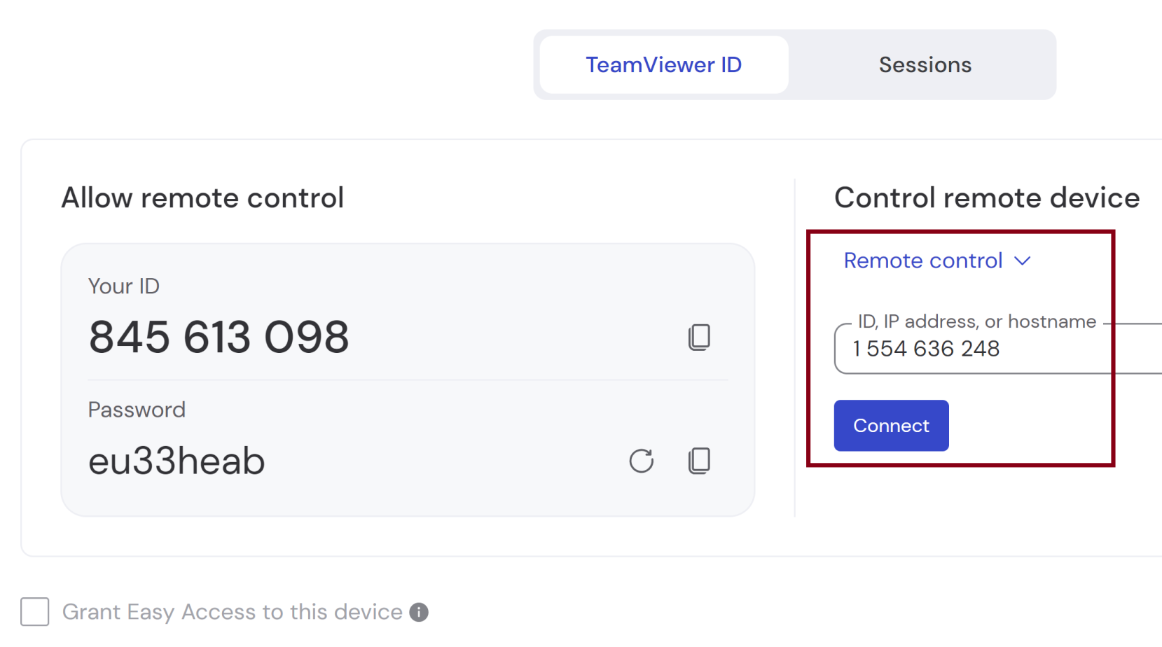
3. Connect to the Remote Server

Slide 14
1. Install tailscale
https://tailscale.com/download

Slide 15

Thank You & See You Again

